Slide 1


Flavors of Punjab
Pride of the Punjabi Palate

Slide 2
ABOUT US
We are a worldwide community, just like the Punjabis, who have won hearts wherever they went, proudly carrying their rich cultural heritage. Punjabis are known for their hospitality and one of the key features that makes it so unique is the food. Our goal is to spread this palate worldwide through the rising culinary entrepreneurs of Punjab.

Slide 3
PROBLEM
With the ever rising number of food
enthusiasts, the restaurant industry has seen
a surge in participants over the last
decade, with the global market reaching a
voluminous 3.4 Trillion U.S Dollars in 2018.
to survive in the gruelling competition of
this ever growing market, formulating every
step, from spot selection to marketing are of
paramount importance and more often than not
end up defining the degree of success of the
enterprise.

Slide 4
SOLUTION
In the current era of technological
Advancement, every industry is turning to
data science for reliable solutions since
data, very much like a picture, speaks a
thousand words, revealing patterns and statistical
inferences beyond the perception of normal
human beings. We here at Flavors of Punjab have
resorted to similar techniques for the betterment
of Indian businesses worldwide as per the need of
the hour.

Slide 5
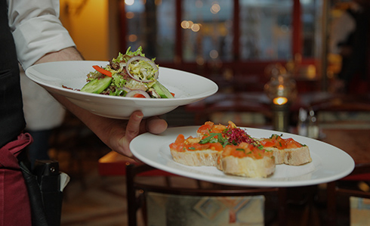


OUR APPLICATION
Section 1
Section 2
We have created a python code that allows us to create a database of local restaurants of a given place using the Foursquare API, and identify areas of interest using clustering methods.
Visualizations are the strongest way of communication of information. Our code also creates interactive maps using the Folium package so that the user can identify the clustered regions of interests on geographical maps using the geo-spatial data from the earlier created databases.

Slide 6
REAL TIME APPLICATION
Case Study : Battle of Neighbors

Slide 7
CASE STUDY
Battle of Neighborhoods
In this case study, we have chosen the city of Toronto, capital of the Ontarion province in Canada, that is home to one of the largest diaspora of the Punjabis. And given the odd million strong Indian diaspora currently residing there, Canada has come up with the most beckoning prospects for Indian youths, trained in culinary arts or hotel management to kick-start their entrepreneurial career prospects in the restaurant business. This case has been used to beta-test our code. Our method for choosing a spot for a Punjabi restaurant
in Toronto is primarily dictated by information about distribution of the Punjabi population in the city coupled with analysis results of the distribution of Restaurants, among other venues in the city; the reason being that the location of public venues in a city is also a pointer of the distribution of its general population. Then we studied the cumulative frequency distribution of restaurants in the city, which allowed us to pinpoint the locations of interest in the city. For this case study we have chosen the localities of Greater Toronto and Scarborough.

Slide 8
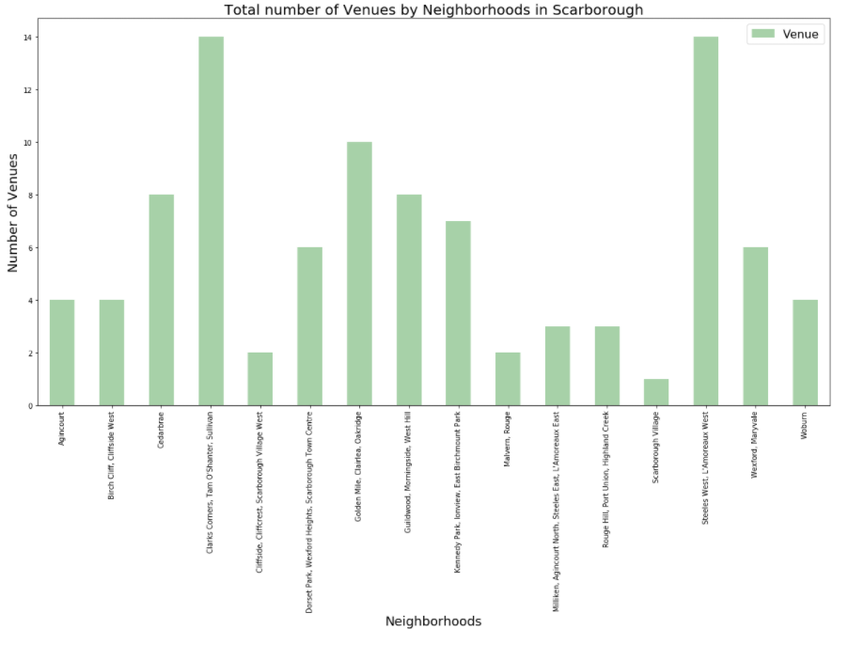
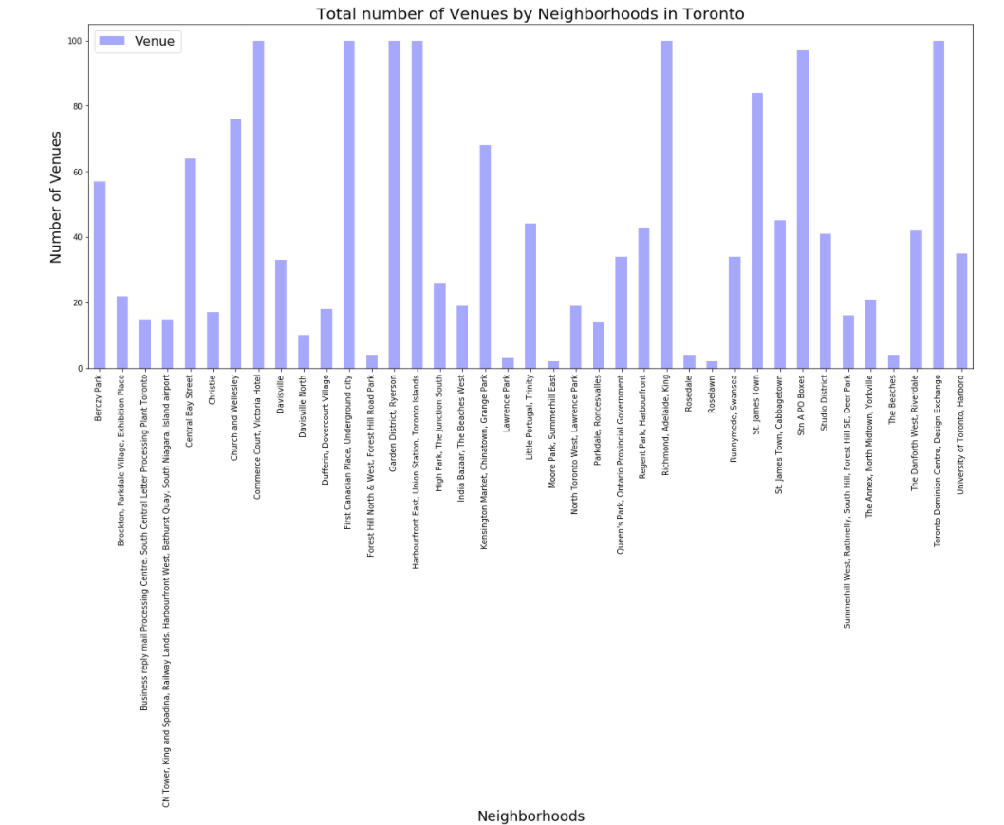
CASE STUDY : Bar Plot showing Distribution of Venues
Battle of Neighborhoods
Scarborough
Greater Toronto

Slide 9
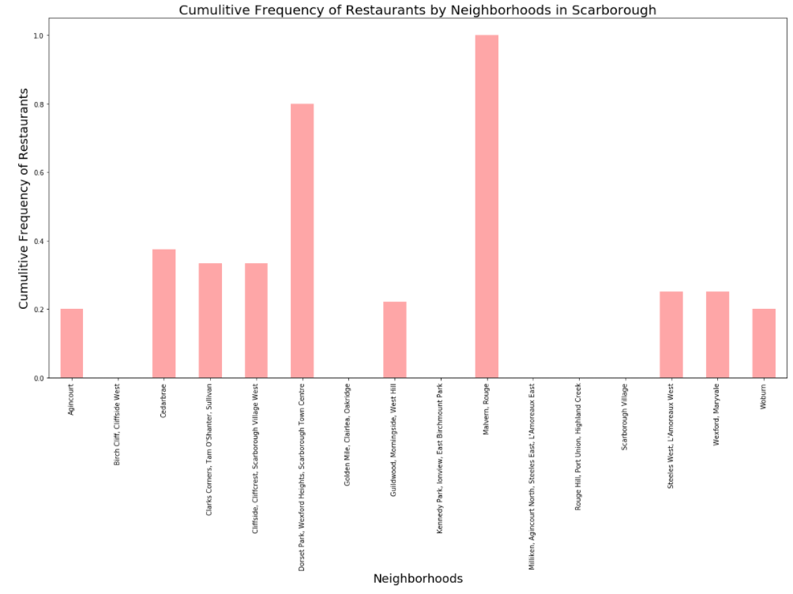
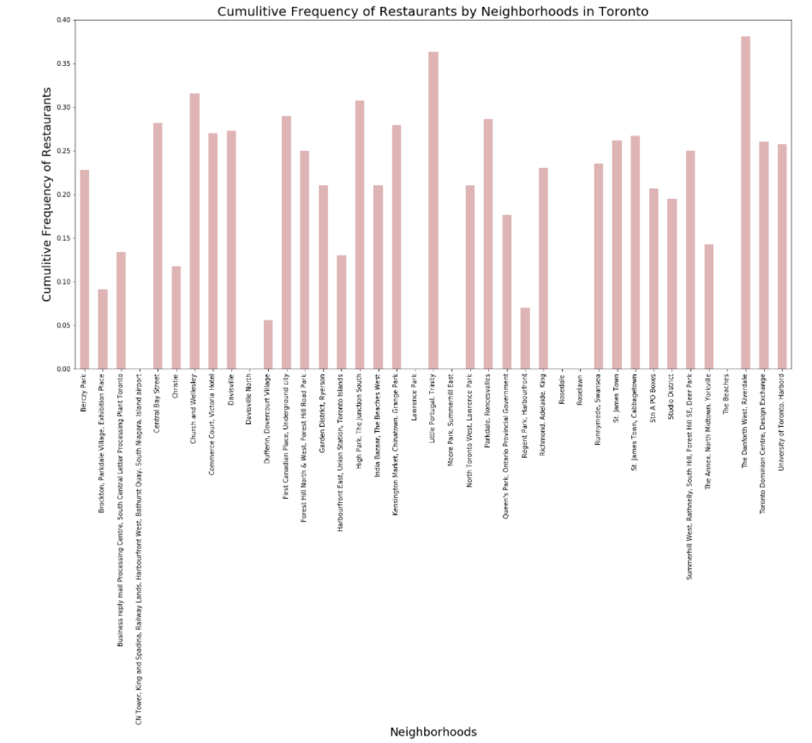
CASE STUDY : Bar Plot showing Distribution of Restaurants
Battle of Neighborhoods
Scarborough
Greater Toronto

Slide 10
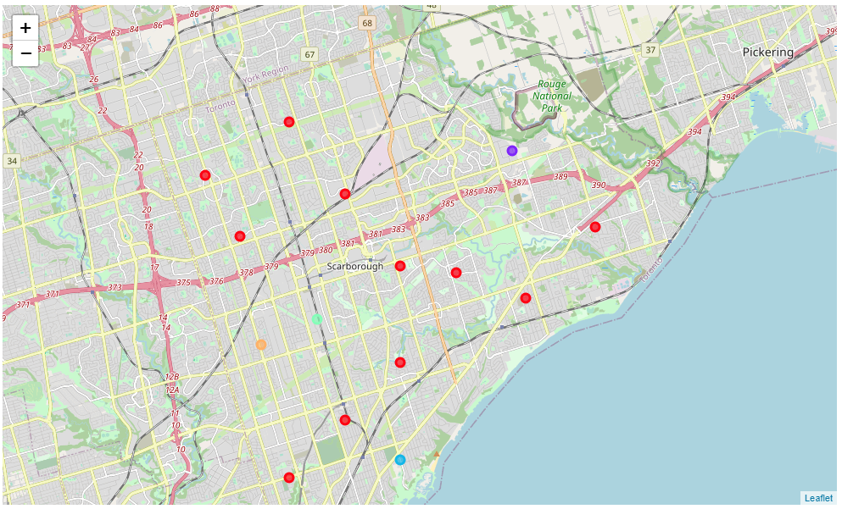
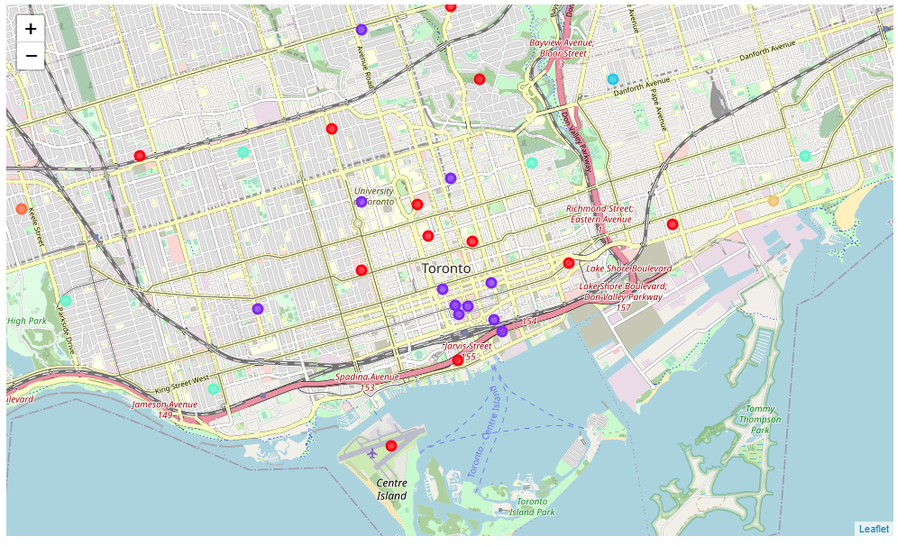
CASE STUDY : Maps showing Distribution of Restaurants
Battle of Neighborhoods
Scarborough
Greater Toronto

Slide 11
Conclusion of Case Study
On the basis of relative comparison the
following neighborhoods were shortlisted for
each locality:
Scarborough | Greater Toronto
Golden Mile, Clairlea, Oakridge, Woodburn and Agincourt | India Bazaar, University of Toronto, Lawrenece Park , Regent Park

Slide 12
THANK YOU!
ASHIS GHOSH
Designation
Coursera Student
Course
IBM APPLIED DATA SCIENCE

Slide 13
Reference Links:
Project Report: https://github.com/razim9087/Coursera_Capstone/blob/master/Capstone%20Project.docx
Source Code of the Application: https://github.com/razim9087/Coursera_Capstone/blob/master/FA_2%20(1).ipynb

